Slide 1

CIS 5200: Team 1
Exploring Electric Vehicle Adoption Through Hadoop-Driven Urban Analysis
Github: https://github.com/abcbbong/EV-Trend
Jae Hoon Lee, Demetris Daniel
Notes:
In github add tableau file, data files, paper and ppt
<a href="https://lordicon.com/">Icons by Lordicon.com</a>

Slide 2


Agenda
Project Introduction
Cluster Specification
Workflow & Implementation
Conclusion
Data Sources
Q & A
Analysis & Visualization
Engineering Process
Recommendations

Slide 3


Introduction
Descriptive Analytics on EV Adoption in Urban Areas
Climate change necessitates promoting sustainable transportation
EV adoption is critical for reducing urban carbon footprints
Examine EV adoption and integration challenges in urban transportation systems
Comparative analysis of California and New York
Data-driven insights in understanding sustainable urban transportation
Notes:
Provide introduction topics in few points, not wordy
Summary points that outline the research purpose
<a href="https://lordicon.com/">Icons by Lordicon.com</a>

Slide 4

Data Sources
EV Registrations Datasets:
California(267MB),Florida(27.3MB), Wisconsin(266MB),
Colorado(2.05MB), Connecticut(357MB), Maine(15.9MB),
Minnesota(12.8MB), Montana(60.7MB), North Carolina (1.75MB),
New Jersey(42.9MB), New Mexico(13MB), New York(776MB),
Oregon(14.2MB), Tennessee(11.8MB) Texas (345MB),
Virginia(21.7MB), Vermont(5.99MB) | TOTAL: 2.2GB
https://www.atlasevhub.com/materials/state-ev-registration-data/#data
Charging Stations Dataset | 39.1MB
https://geodata.bts.gov/datasets/usdot::alternative-fueling-stations/about
CA New ZEV Sales | 2.65MB
https://www.energy.ca.gov/filebrowser/download/6539?fid=6539#block-symsoft-page-title
CA Vehicle Population | 6.32MB
https://www.energy.ca.gov/filebrowser/download/6311?fid=6311#block-symsoft-page-title
Notes:
Same way (name, file size + links)
<a href="https://lordicon.com/">Icons by Lordicon.com</a>

Slide 5



Hadoop Cluster Specifications
Number of nodes | 5 Nodes: 2 Master + 3 Work
OCPUs | 10
CPU Speed | 2195.084 MHz
Memory | 150 GB
Storage | 678 GB
HDFS Capacity | 147 GB
Hadoop Version | 3.2.1
Hive Version | 3.1.2
Notes:
DR WOO WILL PROVIDE THESE DETAILS **

Slide 6

Workflow & Implementation
Dataset Size: 2.2 Gigabytes
Main Dataset Information:
State EV Registration CSVs: registration_date, state, vehicle_name, make, model
Total Python Cleaning Time: 2 minutes
Total time to Create and Populate tables from RAW csv files in Hive: ~2-3 minutes
Notes:
Provide file names, talk about important columns, mention how long the output time is to create and populate the tables, from raw csv to finl output (approximately 2-3 minutes in HiveQl)
Cleaning process about 2 minutes in Python
<a href="https://www.flaticon.com/free-animated-icons/technology" title="technology animated icons">Technology animated icons created by Freepik - Flaticon</a>

Slide 7








Workflow & Implementation
Python/Hadoop/Hive
Local Server
Download
Raw Datasets
Upload To Linux Server
Download
To
HDFS
Clean Data
Process &
Validate
Data
Create External Tables
Export Results
Charts,
Graphs & Visuals
Tableau
Notes:
Provide file names, talk about important columns, mention how long the output time is to create and populate the tables, from raw csv to finl output (approximately 2 minutes in HiveQl)
Cleaning process about 2 minutes in Python
Use workflow chart
,

Slide 8

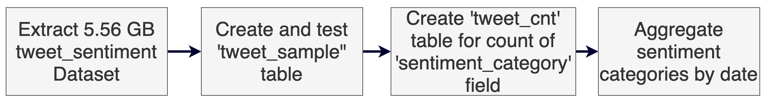
Data Engineering Process
Python utilized to clean enter error issue with the California registrations csv - Vehicle Id column
Organized csv into folders according to data format (CA in ev1, WI,WA,FL in ev2, rest in ev3)
Transferred files to Linux server, upload to HDFS and make directories
Create and insert data into external tables
Create tables with necessary variables from external tables
Kept appropriate column name, data types and order for UNION JOIN
Notes:
<a href="https://www.flaticon.com/free-animated-icons/technology" title="technology animated icons">Technology animated icons created by Freepik - Flaticon</a>

Slide 9

Data Engineering Process
Extracted data from registration_valid_date => r_year, state_abbreviation => state, and make / model were taken from vehicle_name
Summarized tables and grouped data by r_year, state, make and model to sum of registered vehicles count.
Combined all summary tables into a single comprehensive table using UNION ALL function to output all_vehicles_sum
Standardized table with UPPER(make) (model) to convert the fields to uppercase for consistency to output all_veh
Exported final output into HDFS -> Linux system -> Local Computer for Tableau analysis as a csv file
Notes:
Introduction to our analysis

Slide 10

Data Engineering Process
Output Table: All_veh
all_veh.r_year | all_veh.state | all_veh.make | all_veh.model | All_veh.vehicle_count
1987 | TX | CHEVROLET | VOLT | 1.0
1988 | TX | CHEVROLET | VOLT | 2.0
1989 | NY | BLUE BIRD | BB CONVENTIONAL | 136.0
1990 | CO | BLUE BIRD | ALL AMERICAN / ALL CANADA | 31.0
1990 | CO | BLUE BIRD | BB CONVENTIONAL | 43.0
Output file detail and performance:​
​Total Rows: 8,889
File Size: 323KB​
Computation Time ​ ==============➔ 2.93 seconds
Notes:
5 rows of our final output table
Total rows, file size, computation time

Slide 11
Tableau Data Set
All_veh | 323kb
Charging Stations Dataset | 39.1M
CA New ZEV Sales | 2.65MB
CA Vehicle Population | 6.32MB
Notes:
Introduction to our analysis

Slide 12

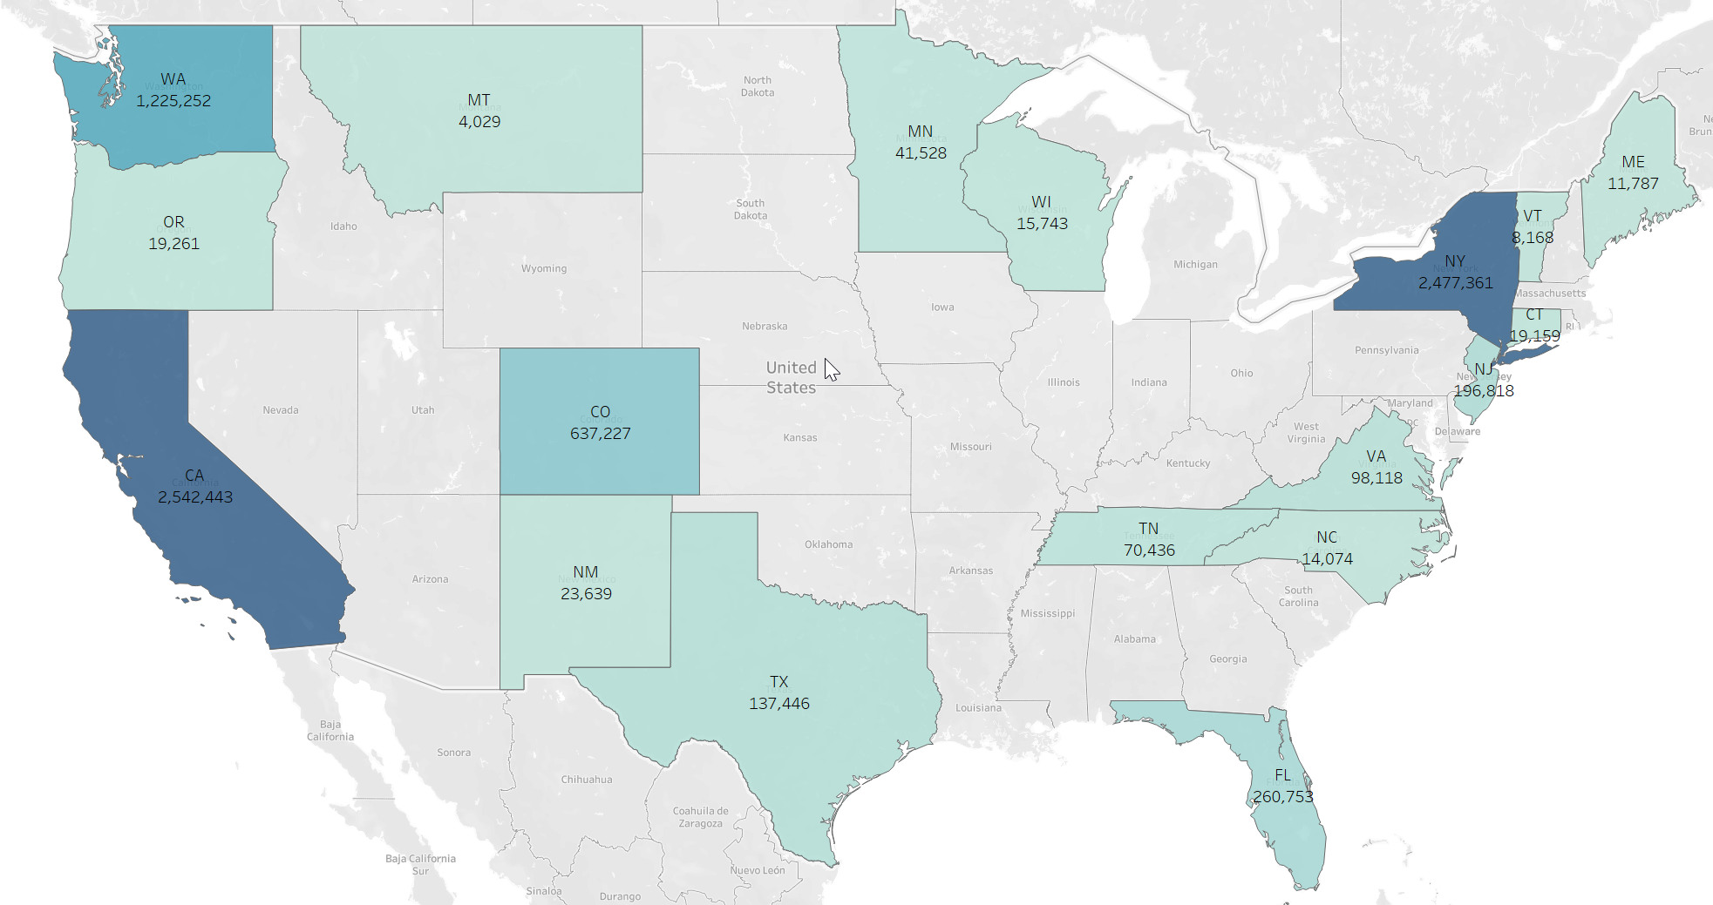
Analysis & Visualization
Analysis 1 – State EV Registrations up to 2020
California leads in EV registrations
New York comparable registrations
Counts include a mix of EV types
Notes:
Insert visualizations one by one

Slide 13
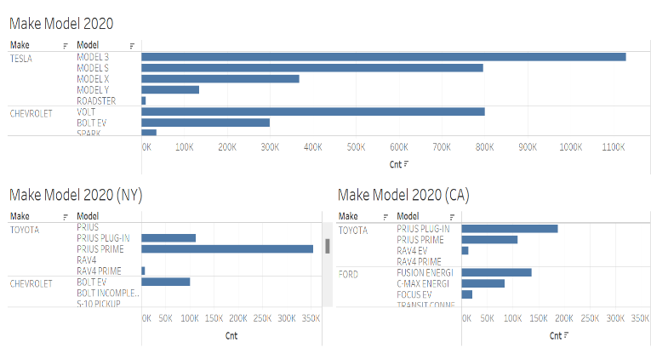
Analysis & Visualization
Analysis 2 – Make/Model Registrations 2020 (CA and NY)
Tesla Model 3 top in sales
Followed by Tesla Model S, Chevrolet Volt, Nissan Leaf & Toyota Prius Prime
In CA Tesla Model 3 & S dominate
IN NY Tesla Model 3 and Toyota Prius Prime lead
New York suggests a preference for hybrid models
Hesitancy to fully transition to ZEV
Notes:
Insert visualizations one by one

Slide 14
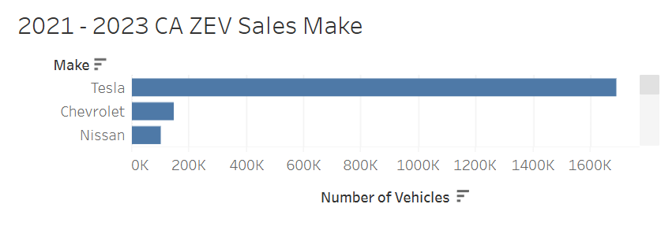
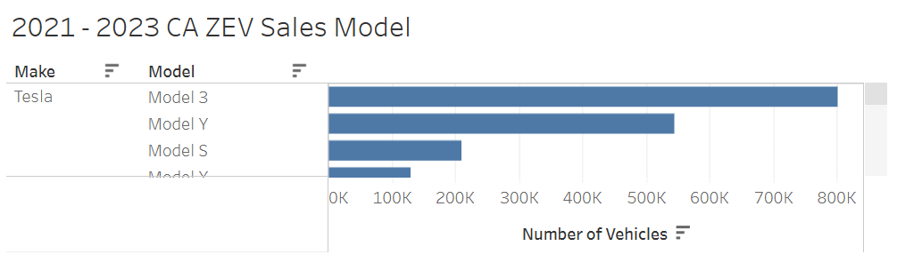
Analysis & Visualization
Analysis 3 – ZEV Market Leaders in CA (2021-2023)
Tesla leads with Model 3 and Model Y
Underscores brand dominance (established reputation, extensive supercharger network, consumer trust in range & performance)
Market share is among a few dominant players, posing barriers to other competitors
Notes:
Insert visualizations one by one

Slide 15
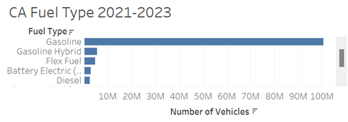
Analysis & Visualization
Analysis 4 – CA Fuel Type Dominance 2021-2023
Gasoline remains the most prevalent fuel type
Battery electric (BEV) a distant second
Highlights persistent reliance on gasoline
Notes:
Insert visualizations one by one

Slide 16
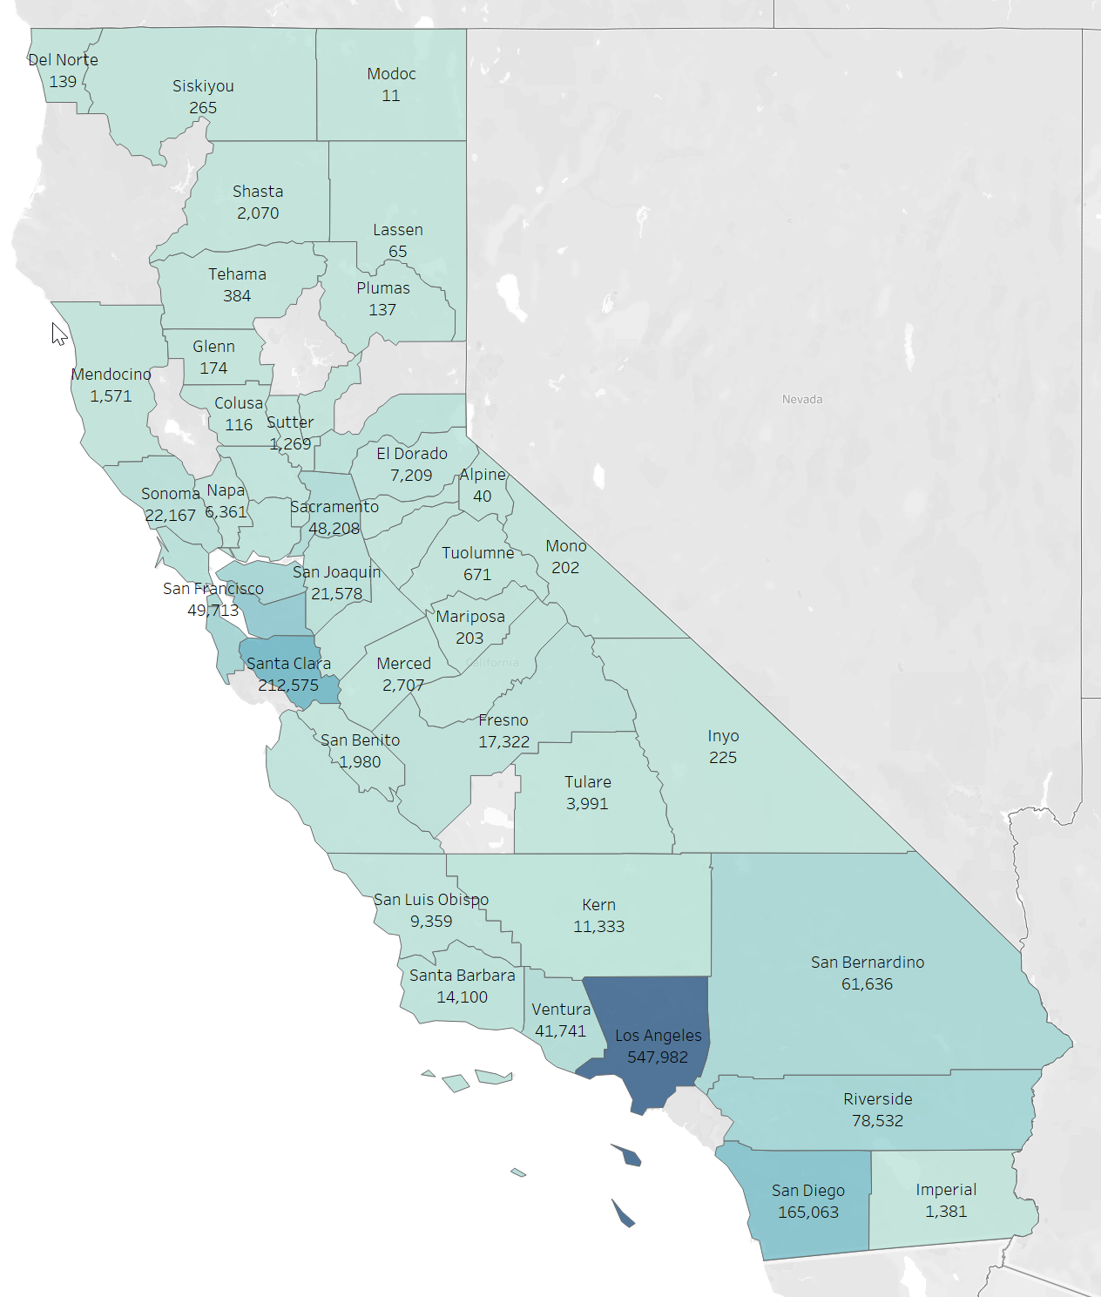
Analysis & Visualization
Analysis 5 – CA County ZEV Registrations 2021-2023
Los Angeles, Santa Clara & San Diego counties lead
Underscore the impact of population density & infrastructure development in driving adoption
State-level incentives tailored to densely populated areas
Notes:
Insert visualizations one by one

Slide 17
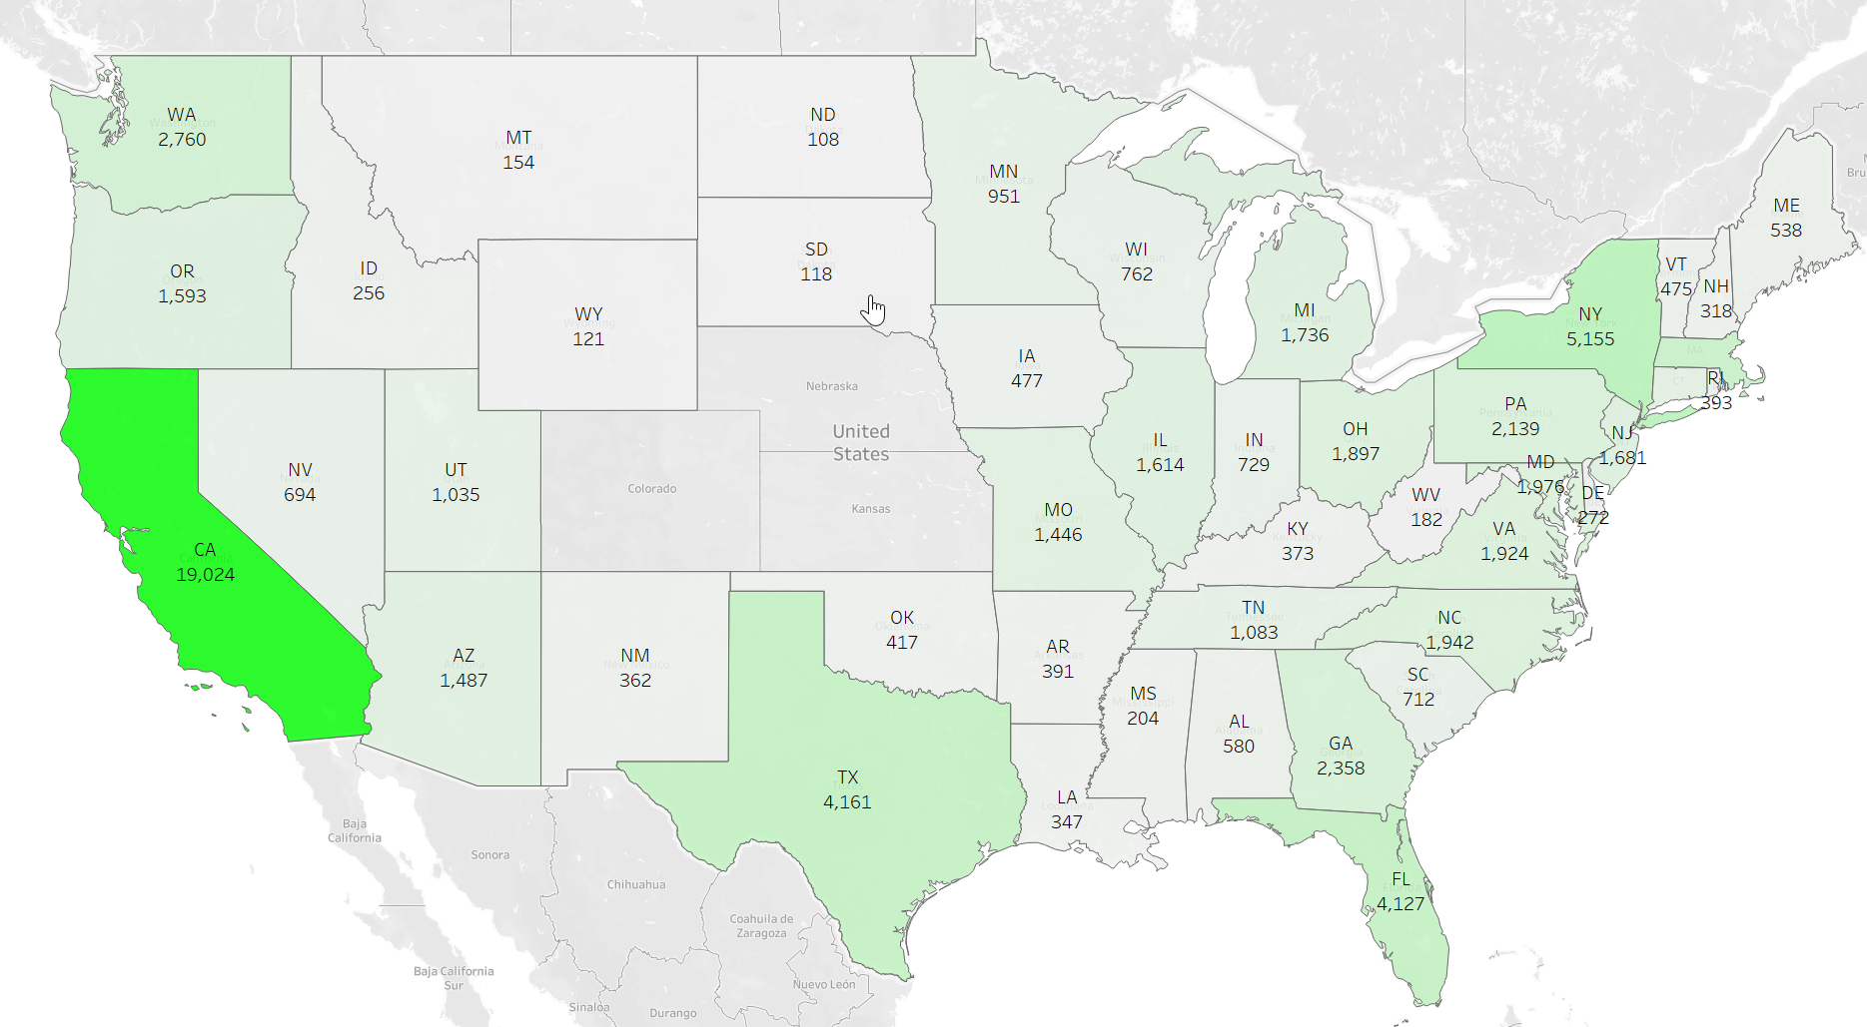

Analysis & Visualization
Analysis 6 – EV Charging Infrastructure Comparison:
CA vs NY (2024)
Significant disparity between CA and NY
CA committed to reduce range anxiety with vast network of Level 2 & 3 chargers
NY limited charging infrastructure acts as barrier
Notes:
Insert visualizations one by one

Slide 18

Conclusion - Observations
CA leads in both EV sales and charging infrastructure
Fosters extensive network of chargers and progressive policies
Challenges in rural and suburban areas where charging infrastructure is limited
In some regions strong hybrid preference persists
Limited space in densely populated areas like NYC restricts the installation of EV chargers
Slow transition from traditional automotive manufacturing to electric vehicle production
Notes:
Insert visualizations one by one

Slide 19
Recommendations
Level 3 fast chargers are essential in urban areas where residents lack private parking or the ability to install Level 2 chargers, addressing key challenges for renters and city dwellers
Needed coordinated approach by governments, private companies, local communities to address barriers for further EV infrastructure development
Focus on availability of high-speed charging stations in the more underserved regions
Provide incentives and increase consumer awareness to accelerate BEV adoption
Notes:
Insert visualizations one by one

Slide 20

Q & A

